Slide 1
Numerical Differentiation
A good approach:
To approximate a derivative of a function whose values are known at a discrete set of points
--> interpolate the values and than differentiate the interpolating function
03/02/09

Slide 2
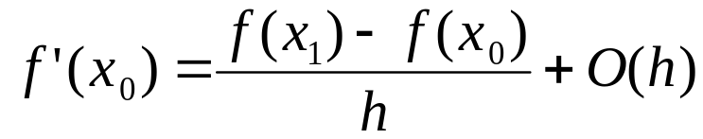
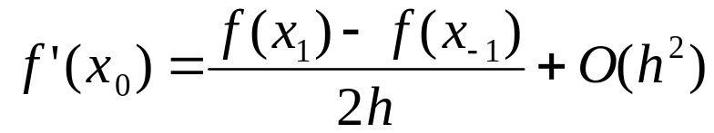
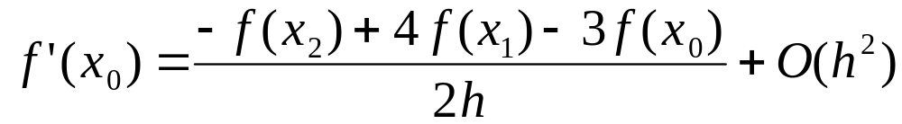
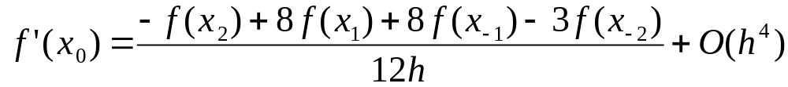
Numerical Differentiation using Polynominals
1st Derivatives
Forward Difference Formula
Central Difference Formula
Forward Difference Formula
Central Difference Formula
5 points
03/02/09

Slide 3
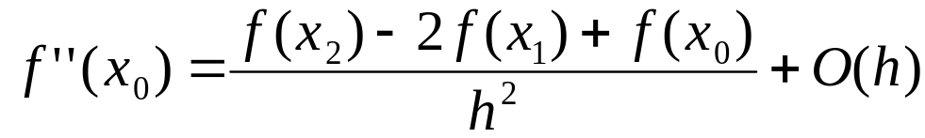
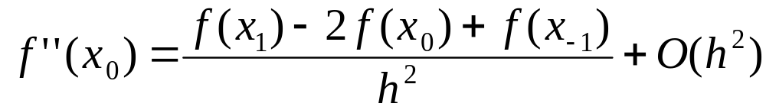
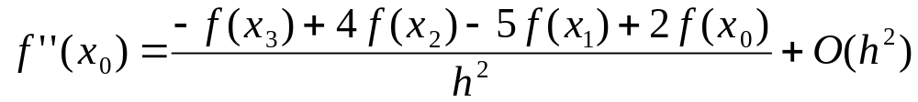
Numerical Differentiation using Polynominals
2nd Derivatives
Forward Difference Formula
Central Difference Formula
Forward Difference Formula
Central Difference Formula
5 points
03/02/09

Slide 4
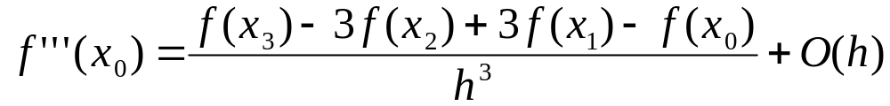
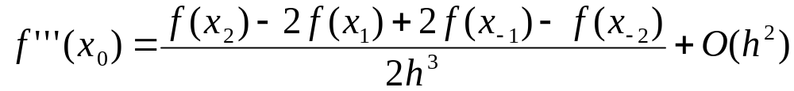
Numerical Differentiation using Polynominals
3nd Derivatives
Forward Difference Formula
Central Difference Formula
03/02/09

Slide 5
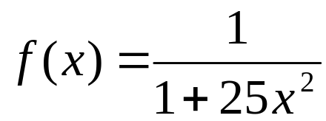
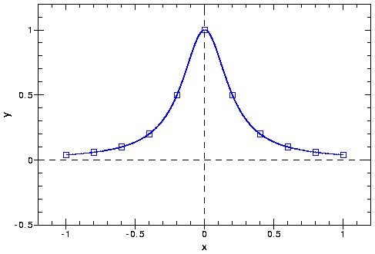
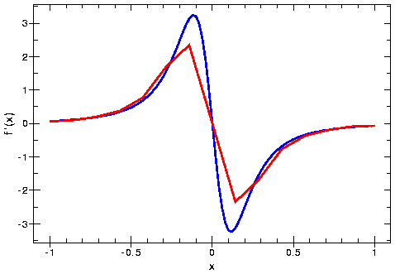
Example of Numerical Differentiation
The Runge Function:
15 points
03/02/09

Slide 6
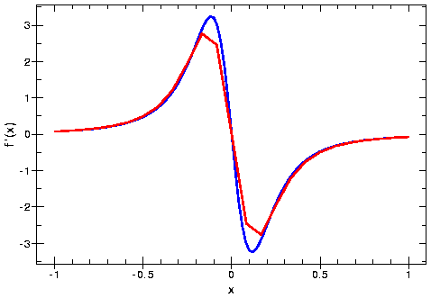
Example of Numerical Differentiation
The Runge Function:
25 points
03/02/09

Slide 7
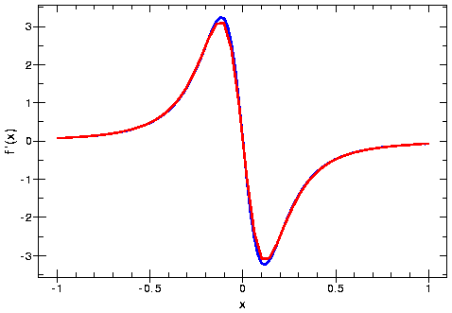
Example of Numerical Differentiation
The Runge Function:
50 points
03/02/09

Slide 8
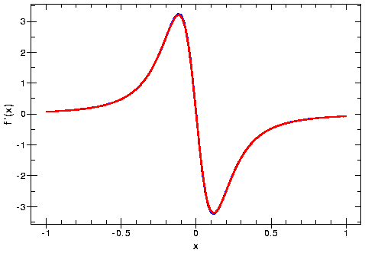
Example of Numerical Differentiation
The Runge Function:
50 points
03/02/09

Slide 9
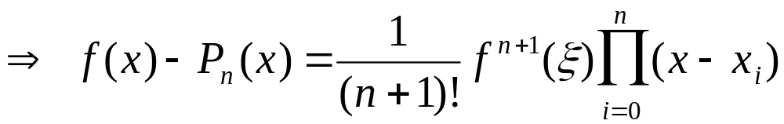
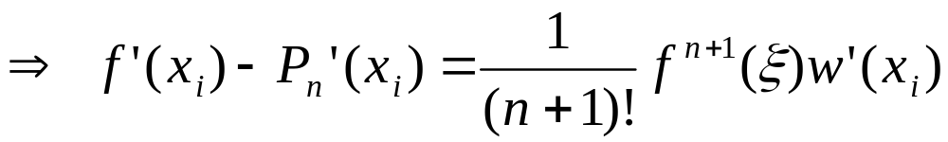
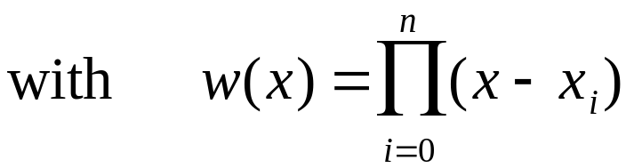
Error Analysis in Numerical Differentiation
The errors of the polynominal interpolation
with ξ being in the interval that has x₀, x_{n}, or x as endpoints.
03/02/09

Slide 10
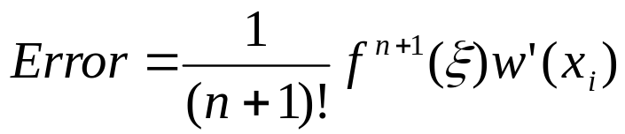
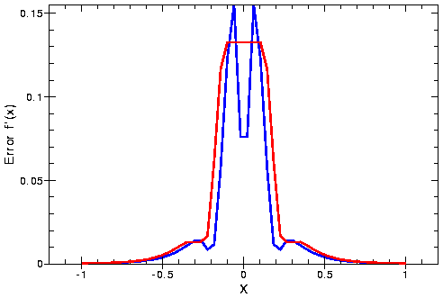
Example of Numerical Differentiation
Use approximation for 3rd Derivative
50 points
Estimated
True
03/02/09

Slide 11
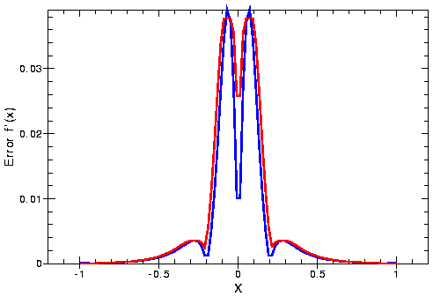
Example of Numerical Differentiation
Use approximation for 3rd Derivative
100 points
Estimated
True
03/02/09

Slide 12
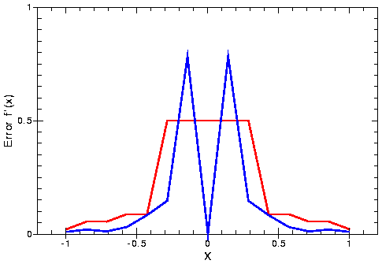
Example of Numerical Differentiation
Use approximation for 3rd Derivative
15 points
Estimated
True
Estimated
True
03/02/09

Slide 13
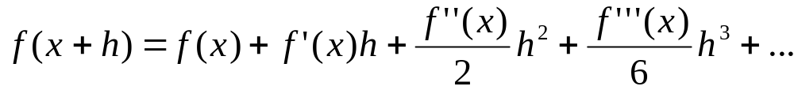
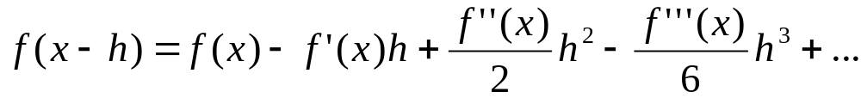
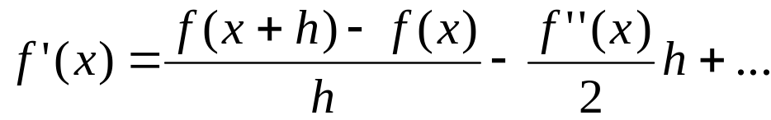
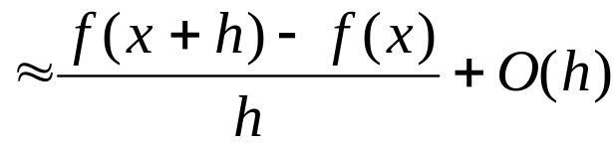
Finite Differences Using Taylor Series
Consider a Taylor series expansion
Using the first series we can obtain the forward difference formula
The dominant term in the remainder of the series is O(h).
03/02/09

Slide 14
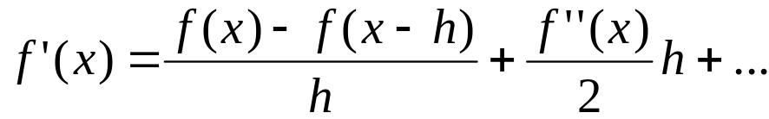
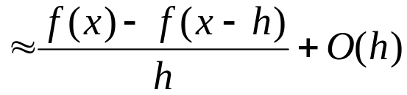
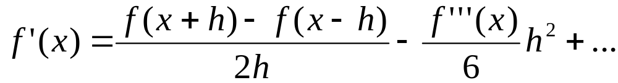
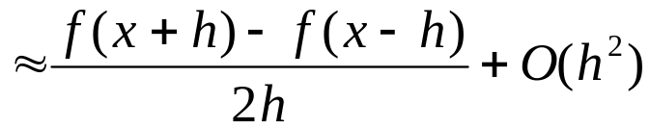
Finite Differences Using Taylor Series
Using the second series we can obtain the backward difference formula
Also of first-order accurate O(h).
Subtracting second series from the first gives the centered difference formula
This is second-order accurate O(h²).
03/02/09

Slide 15
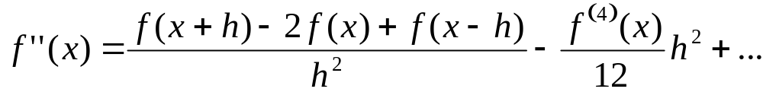
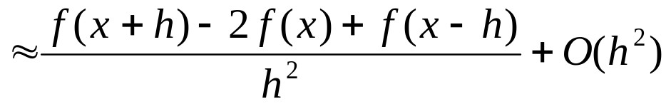
Finite Differences Using Taylor Series
Adding both series together gives the centered difference formula for the second derivative
which is also second-order accurate O(h²).
03/02/09

Slide 16
Richardson Extrapolation
In our previous calculation of the numerical derivative, the approximate value was based on some step size, h.
Ideally: Obtain the limiting value as the step size approaches zero
But we cannot take step size arbitrarily small because of excessive cost or roundoff errors.
Based on values for nonzero stepsizes, however, we may be able to estimate the value for a step size of zero.
One way to do this is called the Richardson extrapolation.
03/02/09

Slide 17

Richardson Extrapolation
Let F(h) denote the value obtained with step size h
Let’s suppose that
with r > p
Assume that we know p and r, but not a₀ and a₁
03/02/09

Slide 18
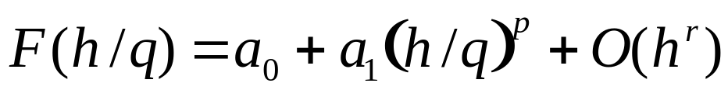

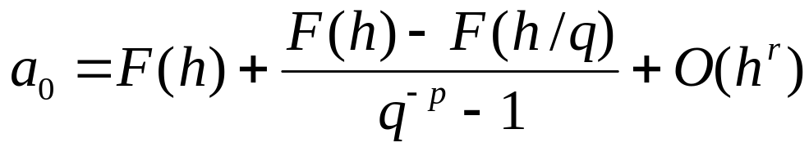
Richardson Extrapolation
Suppose, we have calculated F for two step sizes, h and h/q for some positive integer q
Then we have
This is a system of two linear equations with two unknowns a₀ and a₁
The accuracy of the improved value a₀ is O(h^{r})
03/02/09

Slide 19
Richardson Extrapolation
If F(h) is known for several values of h, than the extrapolation can be repeated to produce an even more accurate approximation.
Although the extrapolated value is an improved value, it is still only an approximation.
Its accuracy is still limited by the step size and the arithmetic precision used.
03/02/09

Slide 20

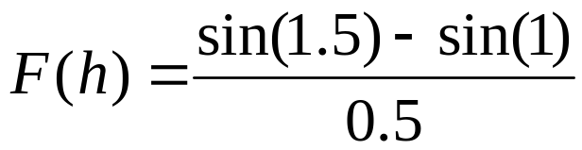

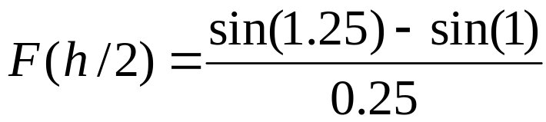

Example of Richardson Extrapolation
Let’s use Richardson extrapolation to improve the accuracy of a numerical derivative of sin(x) at x = 1
Use the first-order accurate forward difference formula
so p = 1 and r = 2 in this example
Using a step size: h=0.5 and h/2=0.25 (i.e., q =2)
03/02/09

Slide 21
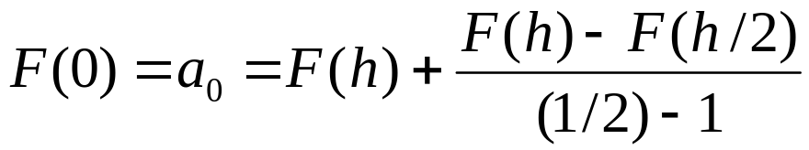

Example of Richardson Extrapolation
The extrapolated value is then given by
For comparison the correctly rounded result is cos(1)=0.540302
With one more iteration in the extrapolation process we get
With the Richardson extrapolation we can significantly improve the accuracy of a low-order approximation formula.
03/02/09

Slide 22
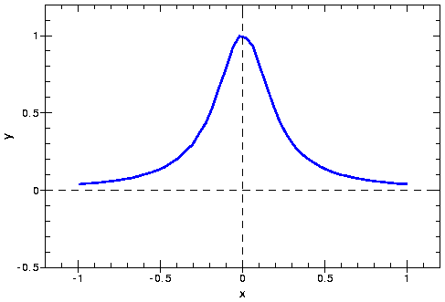
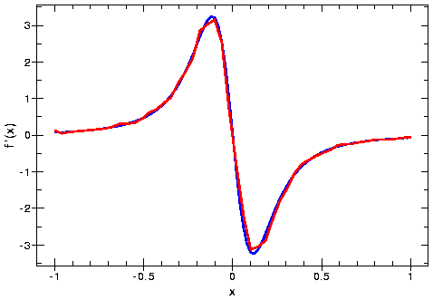
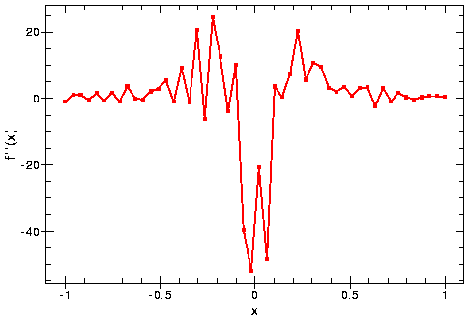
Be Careful
Numerical differentiation is inherently sensitive, as small perturbations can cause large changes in the results
Runge + Noise
1st Derivative
2nd Derivative
03/02/09

